Slide 1
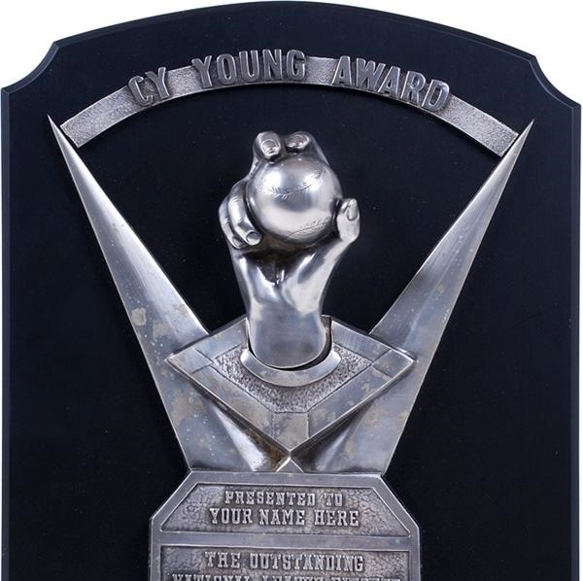
MLB Cy Young: Biased Award or Performance Based?

Slide 2
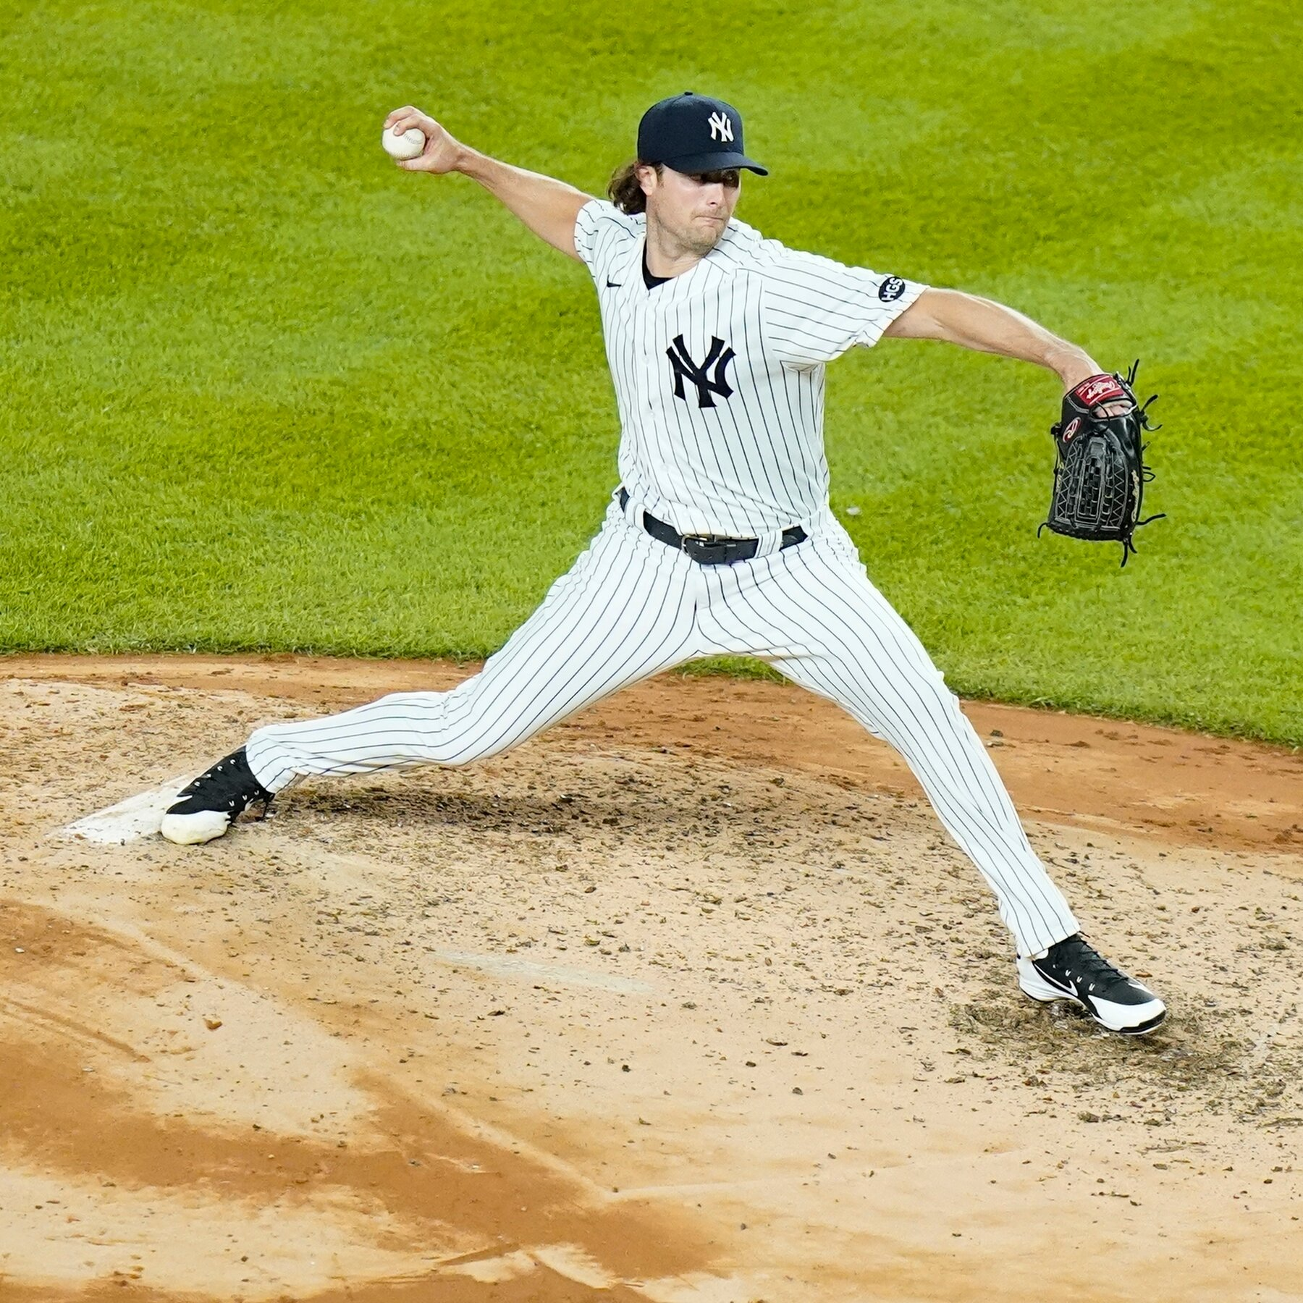
Business Problem
Goal: bridge the gap between historical award recipients and future awardees
ensuring that those who excel in performance statistics receive recognition for their talent
We will utilize statistics of all pitchers, each year, and historical figures to discover discrepancies in awardee consistency and worthiness.
upholds the integrity of the sport
sets a precedent for recognizing exceptionality in a manner that is equitable
aligns with the principles of fairness in the MLB.

Slide 3

Data
The data we used was from the Sean Lahman Baseball Database
We trimmed our data to start at when the Cy Young award started (1956)
The data only includes pitchers that pitched a minimum of 20 games a year
Our final dataset has 6,492 and 31 features
Target variable is "award"

Slide 4
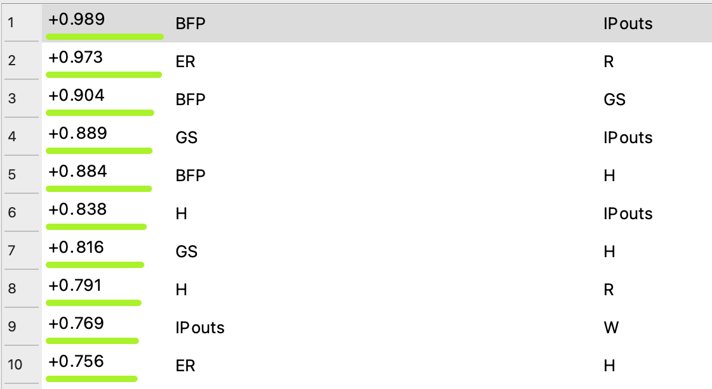
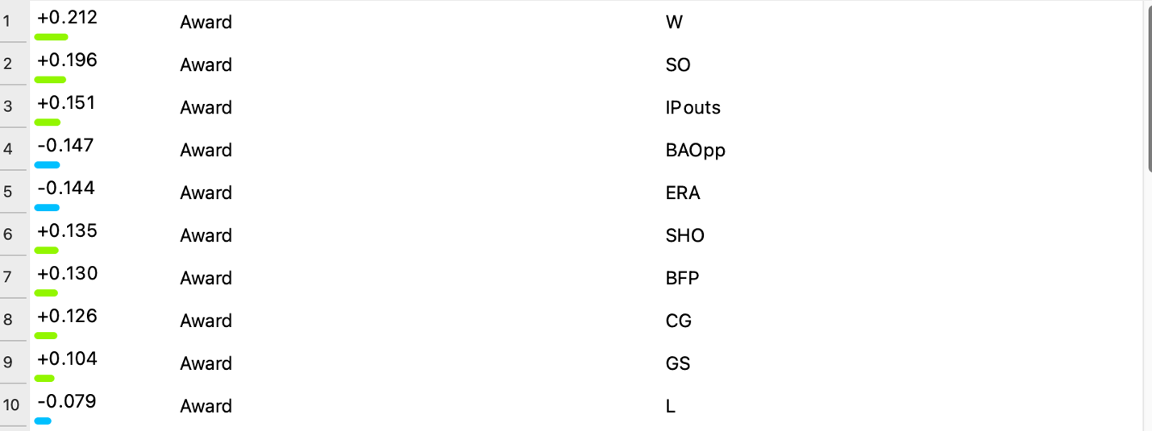
Exploratory Data Analysis (EDA)
Correlations
We completed two forms of correlations
One correlation was an overall correlation for all our variables
The other was a correlation to our target variable, award

Slide 5
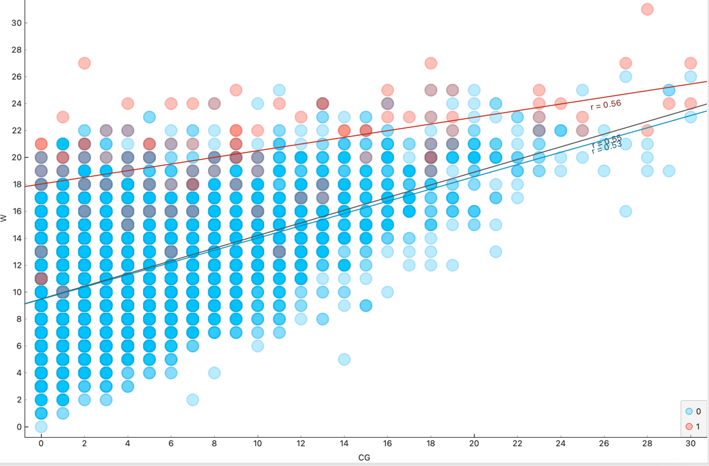
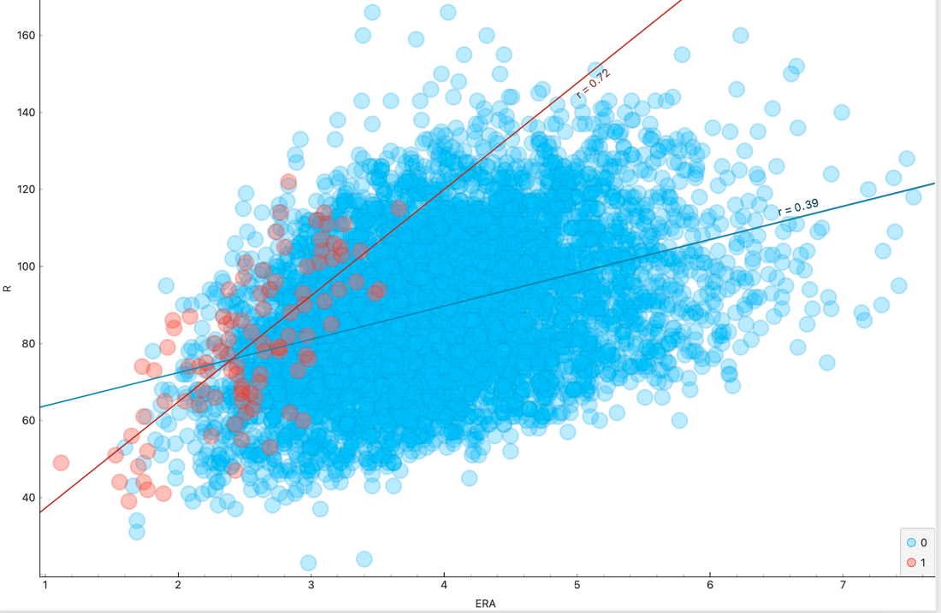
EDAs
This scatter plot shows wins against complete games
Red is award won
Plot shows a trend if more wins than more likely to win the award
Also, possible to win with less wins
This scatter plot it shows ERA and Runs allowed
ERA is the runs scored against the pitchers without the influence of errors or passed balls
Runs tallies the number of runners who score
Red is award won
Important to think of other factors like games pitched

Slide 6
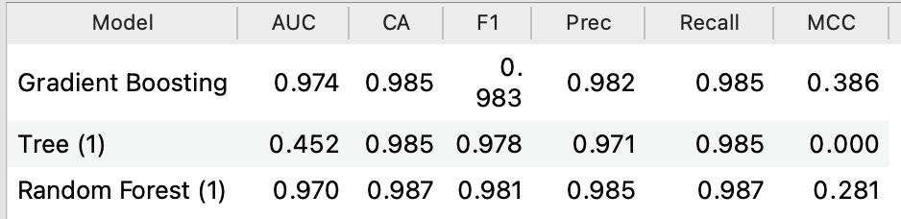
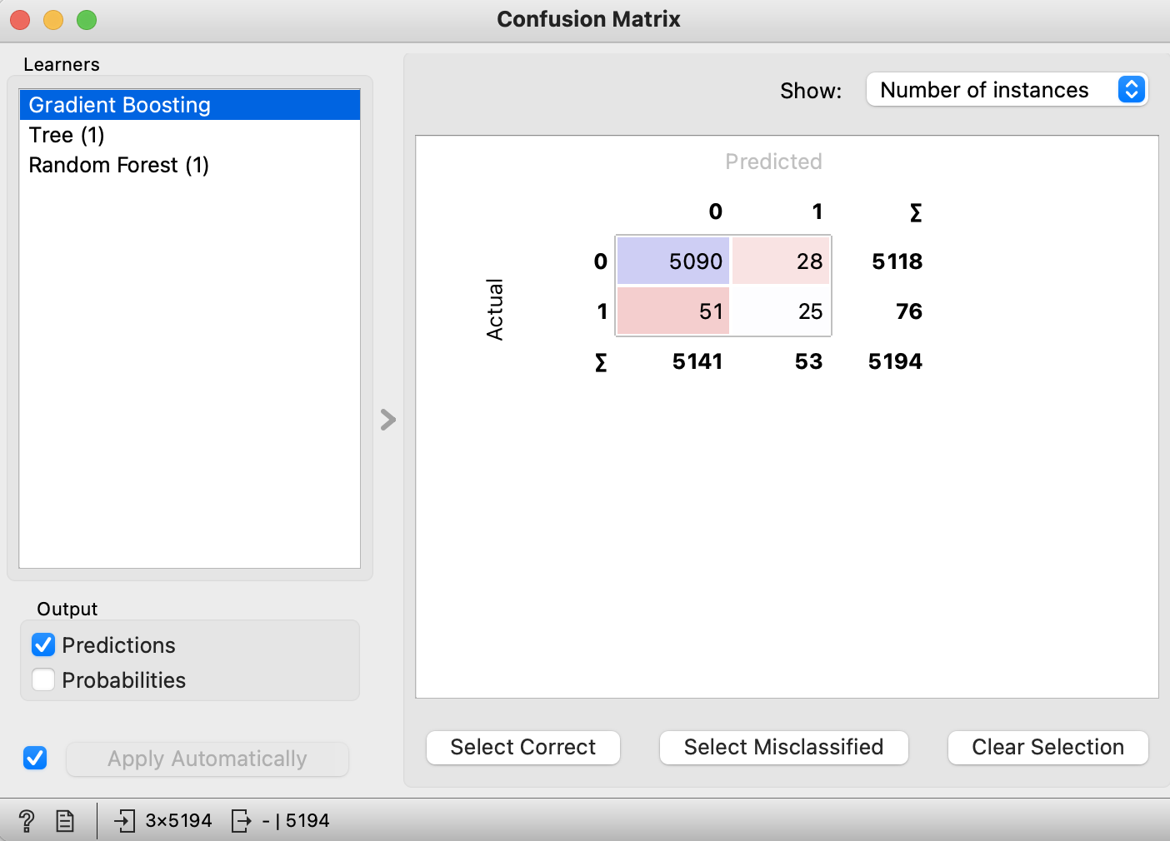
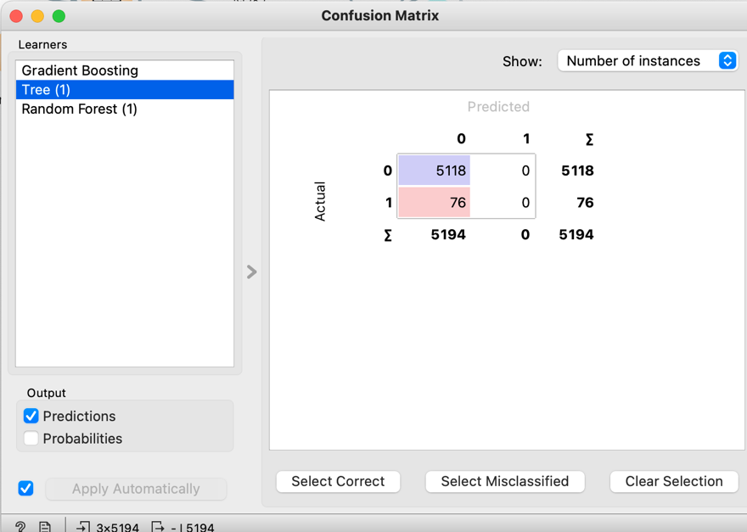
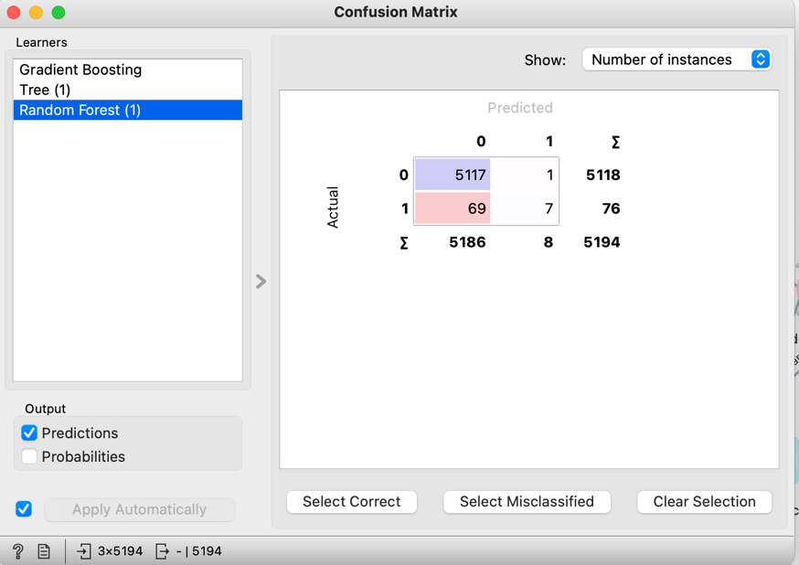
Model Performance
Model performance metrics
Confusion matrix

Slide 7
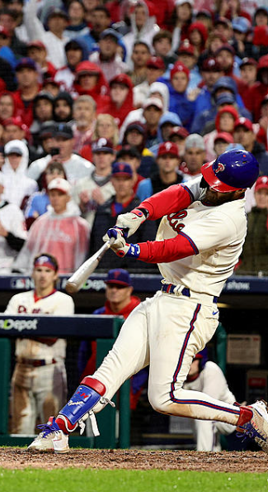
Conclusion
Recommendation
Consistency and Fairness
Limitations
Model subjectivity and performance
External factors
Team dynamics, injuries, contextual game situations
Future Direction
Continual refinement
Holistic and iterative approach
Retrospective analysis

